Slide 1
How to cope with Demand Fluctuations Resilience as the Solution for Volatile Traffic?
InterFAB Research Workshop “Single European Sky and Resilience in ATM”
Sofia, September 16th 2022
Thomas Standfuß¹, Matthias Whittome²
¹ TU Dresden, Institute of Logistics and Aviation
² Functional Airspace Block Europe Central

Slide 2
Agenda
Background
Measuring Volatility
Influence on Performance
Findings

Slide 3
Background Traffic volatility increases, predictability decreases
Situation
European air traffic has always been affected by variations in demand and its flows.
These fluctuations have increased significantly in recent years, culminating due to covid pandemic.
Demand thus became more unpredictable, which significantly limits forecast quality.
While these fluctuations can occur in the very short term, adjusting capacity (and costs) is a long-term process.
Challenge:
A resilient system needs an indicator that measures this constantly changing demand → “Volatility”.
Statistical metrics are available in the academic context and may be applied to air traffic figures.
Source: Worldbank Open Data, Carrier Departures

Slide 4
Measuring Volatility Scope and metrics
Temporal Disaggregation
Volatility may act at different time intervals.
We distinguish three parts:
The seasonality is considered to be long-term volatility. → VOL_LT
Medium-term volatility addresses daily fluctuations within a week. As an example, traffic tends to be lower at weekends.
→ VOL_MT
Traffic fluctuations over one day are considered as short-term volatility (VOL_ST). It is mainly caused by a (relatively) low demand during nighttime.
Depending on the time interval, different data sources are available, such as NEST data (hourly) or PRU data (daily).
Requirement Engineering
A metric should reflect changes in demand appropriately (sensitivity regarding traffic scenarios),
It should consider pan-European heterogeneity,
It should be applicable on different operational levels.
Some Potential Metrics
$σ=\sqrt{\frac{1}{n}∙\sum_{i=1}^{n}{{\left(R_{i}−µ\right)}^{2}}}$ → scale dependent
$GINI=\frac{2∙\sum_{i=1}^{n}{i∙x_{i}}}{n∙\sum_{i=1}^{n}{x_{i}}}−\frac{n+1}{n}$ → scale independent
Focus

Slide 5
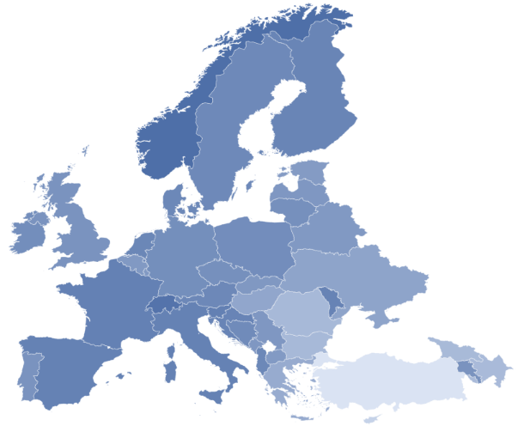
Measuring Volatility Pan-European differences and disaggregation
Short-Term
Disaggregation
The darker the shape, the higher the traffic volatility
Traffic volatility is higher on lower operational levels

Slide 6
Influence on Performance Model and method
Factor | Metric | Meaning
AIRP | 0/1 | Airport Ownership
COORD | Nb | Coordination – Number of neighboring airspaces
COSTS | € | Employment costs per ATCO
DELATM | 0/1 | Delegated ATM
DENSITY | Score | Traffic Density
DOM | % | Share of domestic flights
HI | Score | Horizontal Interactions
JSC | 0/1 | Joint Stock Company
L_AIRP | Nb | Number of hubs (>200.000 movements p.a.)
MET | 0/1 | MET Services
NOFAB | 0/1 | ANSP is no member of a Functional Airspace Block
NONA | % | Share of Non-ATCOs
OCEAN | 0/1 | Oceanic Airspace
OVER | % | Share of overflights
RES | Nb. | Technology proxy
SI | Score | Speed Interactions
SIZE | Km² | Airspace Size
STATE | 0/1 | State-Owned
TIME | h | Working time per ATCO
VI | Score | Vertical Interactions
VOL_LT | % | Seasonality
VOL_MT | % | Weekly Volatility
VOL_ST | % | Daily Volatility
WEALTH | € | Wealth of the country, GDP per Capita
Goals
High volatility is expected to hamper productivity:
however, there are multiple further influencing factors.
Does each score affect performance equally?
Method applied: Regression Analysis.
The model represents an extension of the analyses of a PhD-study. It considers exogenous, partially exogenous, and endogenous factors.
The dependent variable is represented by ATCO productivity (see PRU / EUROCONTROL reports).
VOL_ST, _MT, and _LT represent the volatility factors.
Airspace and traffic characteristics, ownership forms, and socio-economic factors are considered as well.
We calculated both cross-sectional and panel models.

Slide 7
Influence on Performance Volatility decreases productivity of ANSPs
Results:
The shown result represents one specification using cross-sectional data.
Using the eight selected variables, the ATCO productivity can be resolved by 79%.
Both long- and short-term volatility scores have a negative sign, indicating that they decrease productivity.
All variables are statistically significant. Thus, the interdependency is statistically proven and not purely random.
Results are similar using different models.
Variable | Coefficient
const | -0,36 (0,493)***
l_size | 0,219 (0,064)***
OVER | 0,592 (0,141)***
VOL_LT | -2,142 (0,621)***
VOL_ST | -1,548 (0,727)*
MAPE | -0,145 (0,082)*
COSTS | 0,003 (0,001)***
JSC | 0,158 (0,058)**
Adj. R² | 0,79

Slide 8
Influence on Performance Volatility also increases the CRSTMP-Delay
Variable | Germany (DFS) | France (DSNA)
const | 0,47 (0,96) | -4,70 (1,03)***
DEM | 0,0005 (6,2e-5)*** | 0,0008 (8,6e-5)***
VOL_ST | 3,19 (1,87)* | 23,57 (2,28)***
ATMAP | 0,04 (0,02)** | 0,02 (0,02)
CO2P | -0,007 (0,01) | 0,09 (0,02)***
FuelP | 0,29 (0,15)* | -1,41 (0,19)***
Y2016 | 0,64 (0,09)*** | -0,01 (0,12)
Y2017 | 1,10 (0,08)*** | -0,38 (0,12)***
Y2018 | 3,18 (0,15)*** | -0,29 (0,20)
Y2019 | 2,37 (0,23)*** | -1,41 (0,31)***
Adj. R² | 0,72 | 0,58
Using a different regression model, we estimated the influence of short-term volatility (GINI) on CRSTMP delay.
Model included e.g., weather (ATMAP), prices for CO2 and kerosine, and the overall demand.
We use panel models, including yearly dummies.
Regression was applied for each ANSP separately, using daily data. The examples show German DFS and French DSNA.
Variables were log-transformed in advance to show the relative influence on delay.
The result on the right side shows one example for German DFS (left) and one for French DSNA (right).
Short-term volatility increases CRSTMP delay.
It also has the highest (relative) influence.
Model quality is still high (approx. 72%, respectively 58%).

Slide 9
Findings Volatility exists, is measurable, and influences performance
Traffic became less predictable over the past years due to both external shocks and subsequent traffic fluctuations.
These fluctuations can be measured by scientifically sound statistical indicators.
We have empirically shown that high volatility increases delay, and decreases the productivity of ANSPs.
It is therefore recommended to apply meaningful indicators regularly, evaluating both forecast quality and volatility.
Monitoring volatility in its different time horizons enables estimating the need for resiliency in the system, respectively the ANSP.

Slide 10
Thank you Много благодарности
POC: Thomas Standfuss
TU Dresden
Institute of Logistics and Aviation
Chair of Air Transport Technology and Logistics
Thomas.Standfuss@tu-dresden.de
Tel.+49 351 463-36834
Fax+49 351 463-36898

